Slide 1
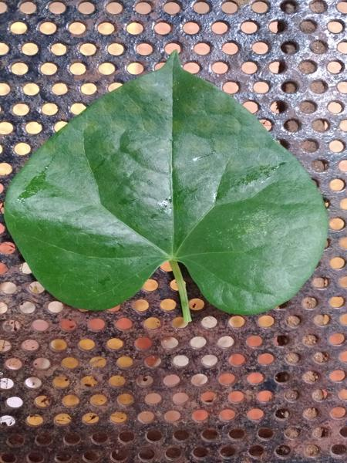
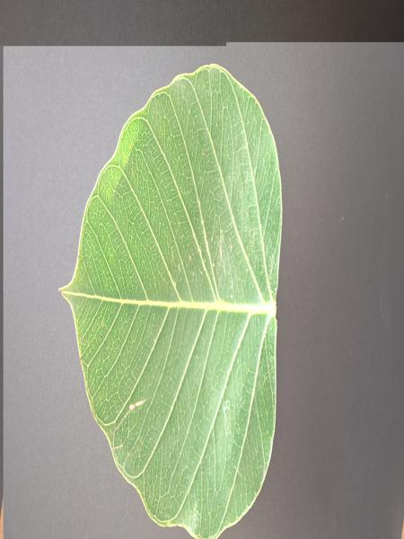
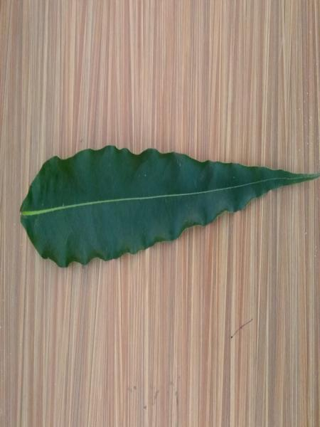
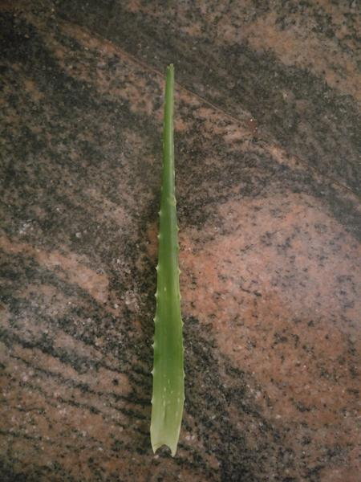
AI-BASED MEDICINAL PLANT DETECTION
Chandan Kumar(211301) Awanish Thakur (211114)

Slide 2
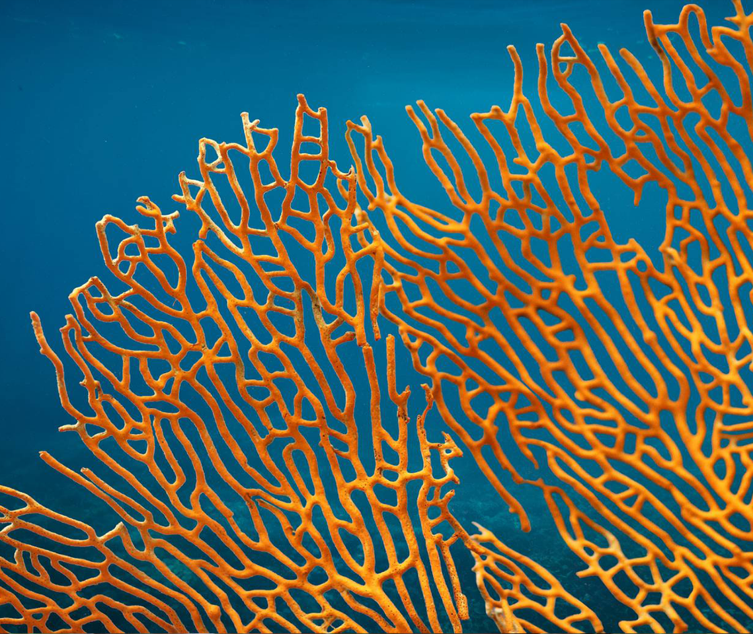
AGENDA
Introduction
Objective And Motivation
Literature Review
Dataset
Technical Overview
Model Result
Limitation and Future Work
Conclusion
References

Slide 3
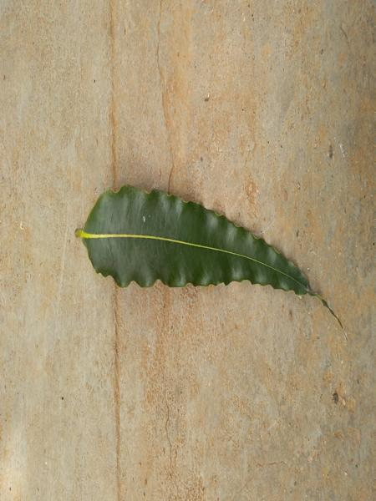
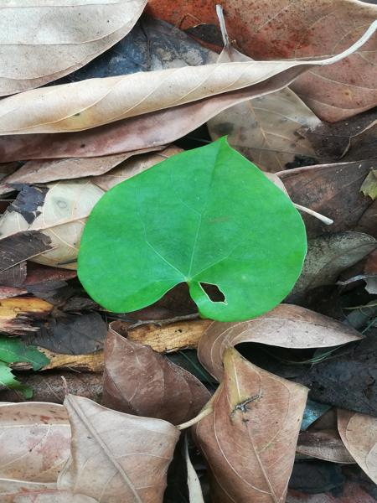
INTRODUCTION
With the rapid evolution of technology, there is an increasing need for advancements in botany, particularly in the identification of medicinal plants.
Traditional methods of plant identification are often time-consuming and prone to errors.
This project aims to automate the recognition of medicinal plants using artificial intelligence.

Slide 4
Objective and Motivation
Primary Objective: To develop an automated system that can accurately and efficiently recognize and classify Indian medicinal plants from images.
Secondary Objectives:
Aid in the identification and preservation of medicinal plants.
Contribute to healthcare by making identifying plants with medicinal properties easier.
Support biodiversity conservation efforts by accurately identifying plant species.
Need for efficient recognition systems: The traditional plant identification methods are labour-intensive and require expert knowledge.
Traditional Medicine:
Many communities rely on medicinal plants for primary healthcare.
Accurate identification is crucial for the effective use of these plants.
The diversity of plant species makes manual identification challenging.

Slide 5
Literature Review
S.No. | Year and Author Name | Dataset | Method | Accuracy | Limitation
1 | Biplob Dey Jannatul Ferdous [2024] | 5878 images of 30 medicinal species | VGG16, VGG19, DenseNet201, InceptionResNetV2,and InceptionV3 | P1=99.64% In PF1=97% | Environmental and natural impact is not recorded
2 | *Parismita Sharma, ∗Parvez Aziz Boruaha [2023] | 77500 images of 117 species | Unet(gray scale) | Train Accuracy 96.33% Value accuracy 95.49% | Cover only a small area or local plant
3 | *Pushpa B R ∗N. Shobha Rani [2023] | The datasets consist of 5900 images of 40 plant species and 6900 leaf images of 80 species | Data augmentation is applied to medicinal plant datasets. |  | Consists data of from a botanical garden in Kerala.

Slide 6
4 | *S. Kavitha *T. Satish Kumar | 500 images of each 6 plant species. | DL model | 98.3% | This sample is just for six medicinal plants.
5 | *Xin Sun * Huinan Qian [2022] | It contains 95 herb categories with 5640 images | The DNN method is used | Top 1=68.89% Top 5=88.03% | Need Professionals to identify very high resources
6 | Nilesh S. Bhelkar Dr. Avinash Sharma | In this work, 45 distinct medicinal plant leaves were used | Deep learning (DL) model Deep convolutional neural networks | 97.65% | The data is only limited to Indian herbal plants
7 | Rahim Azadnia Mohammed Maitham Al-Amidi | 5 Different plant species | Convolutional Neural Network (CNN) | 99.3% | The leaves change throughout the year due to changes in weather conditions and in different places same species look different

Slide 7
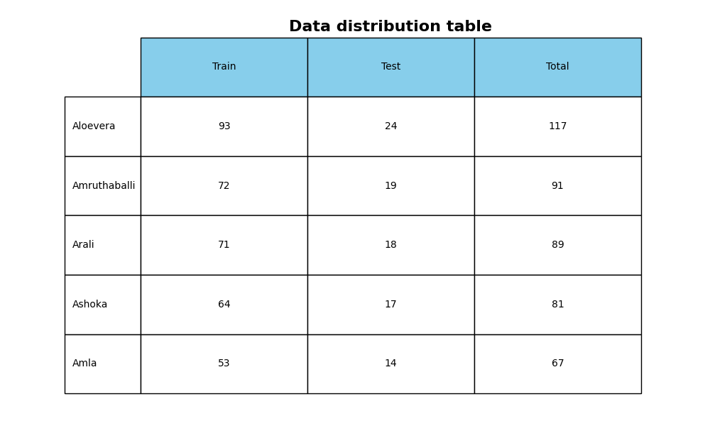
Dataset
About Dataset
Indian Medicinal Plant Datasets is a repository that consists of medicinal plant images. The images are captured with varying backgrounds without any environmental constraints
Summary
Indian Medicinal Leaves Image datasets
2 directory(Leave and plant) 12.8K Image.

Slide 8
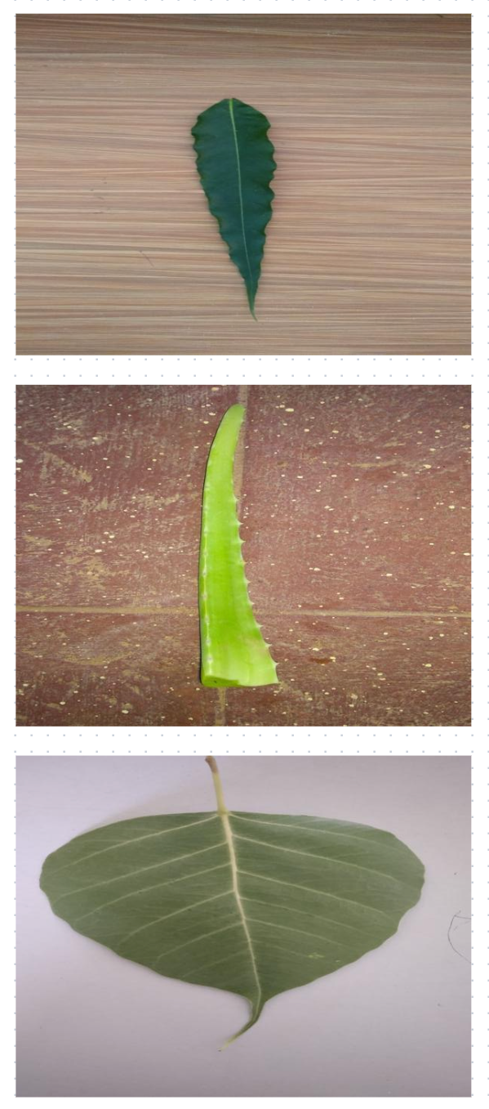
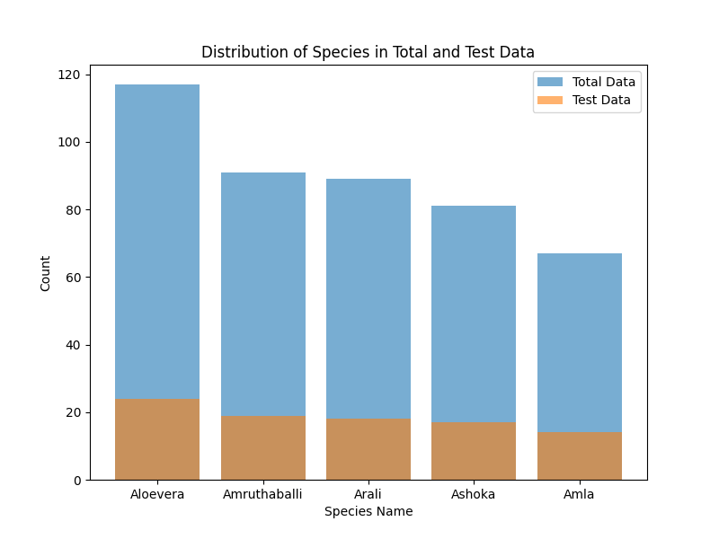
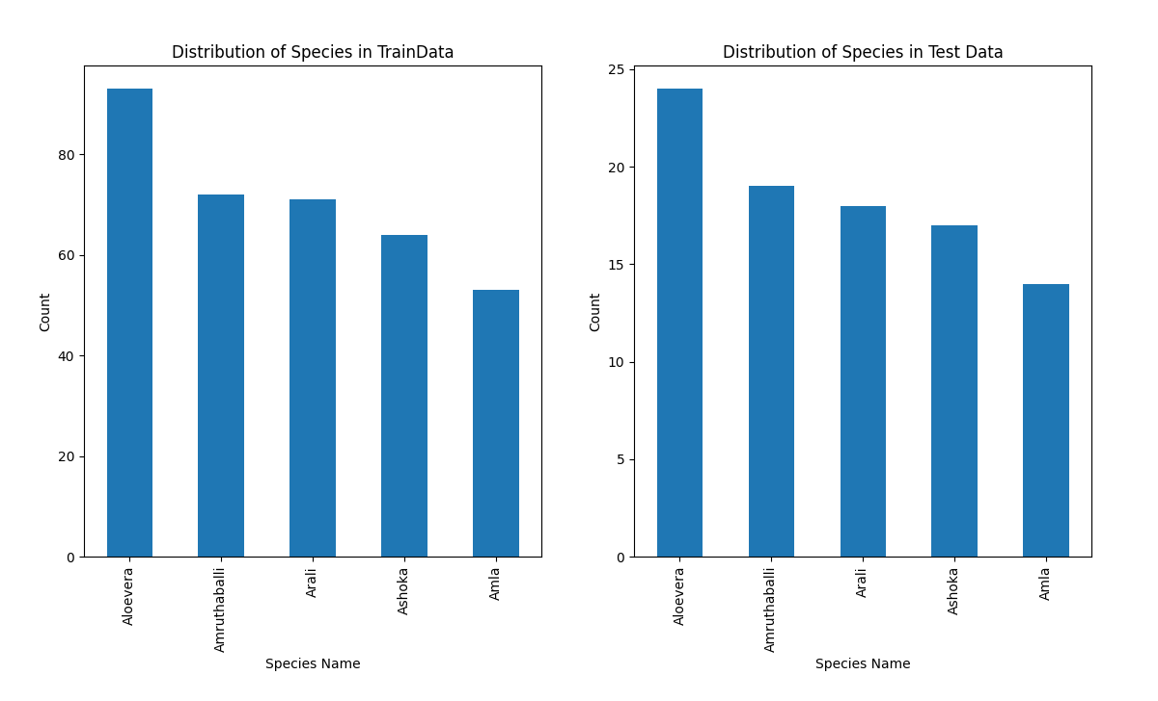
USED DATASET COMPOSITION

Slide 9
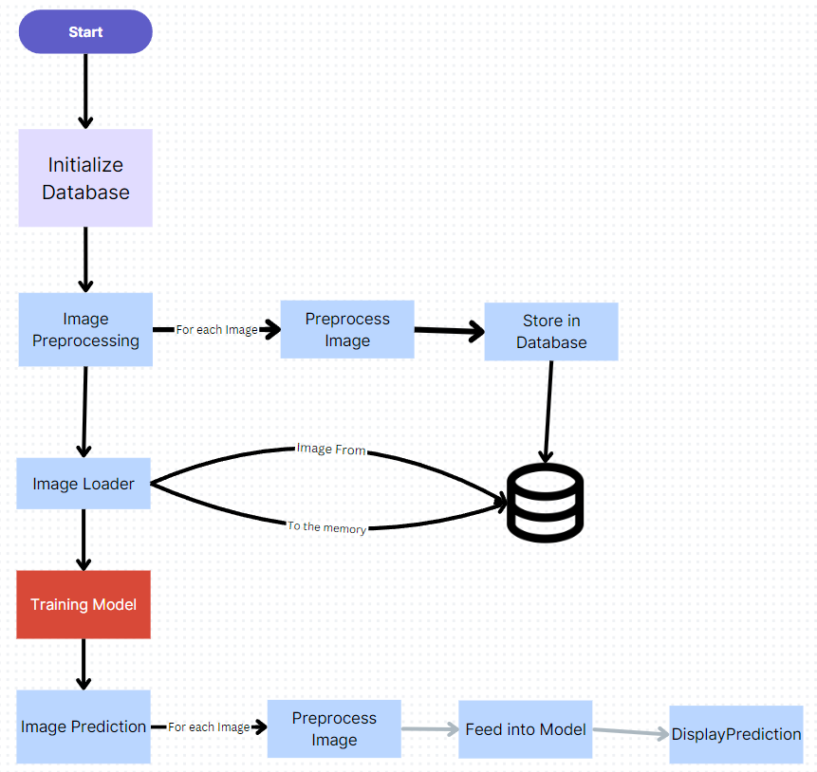
Technical Overview
Languages: The project utilizes C# and Python.
Libraries:
Emgu CV for image processing tasks.
TensorFlow for machine learning and model training.
Npgsql for database connectivity and management.
Techniques:
Data augmentation to increase the diversity of training data.
Background removal to focus on the plant features.

Slide 10
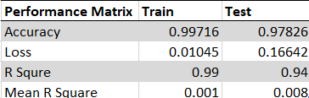
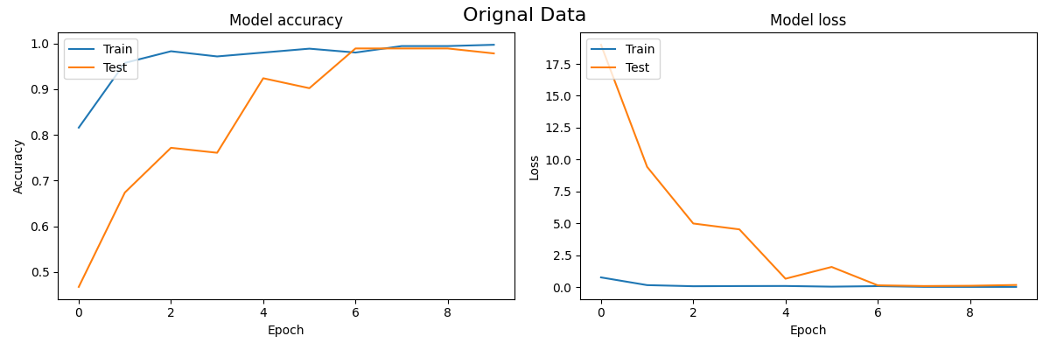
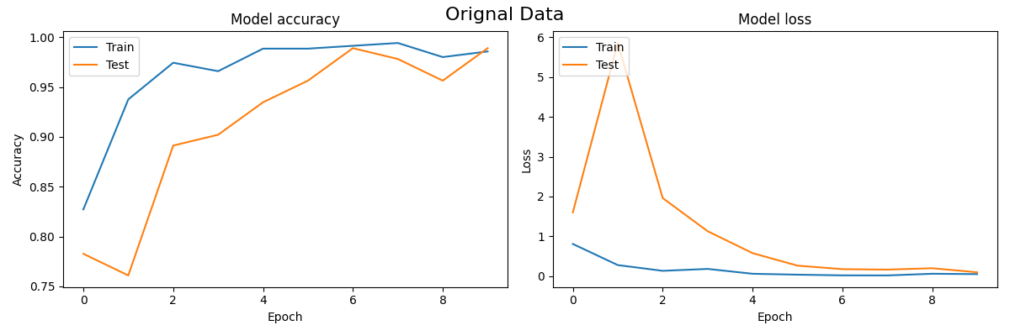
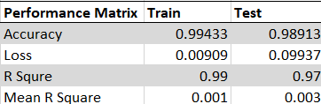
Model Result
Inception V3
Inception Resnet V2

Slide 11
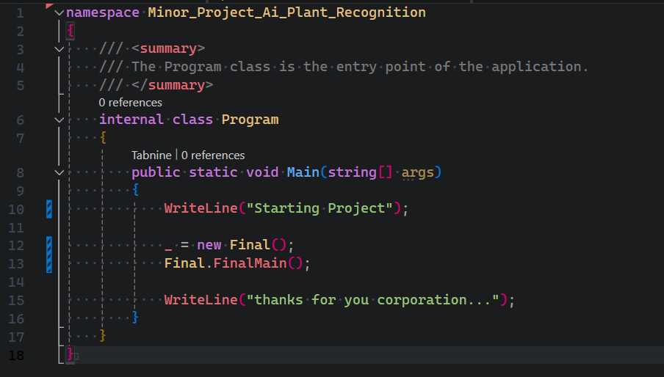
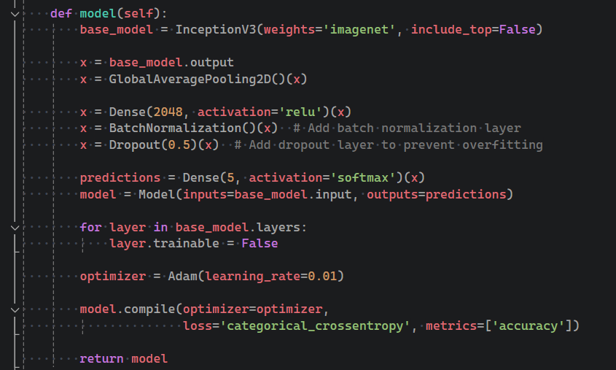




Implementation
PLANNING
MARKETING
DESIGNING
STRATEGY
Synergize scalable e-commerce
Disseminate standardized metrics
Disseminate standardized metrics
Foster holistically superior methodologies

Slide 12
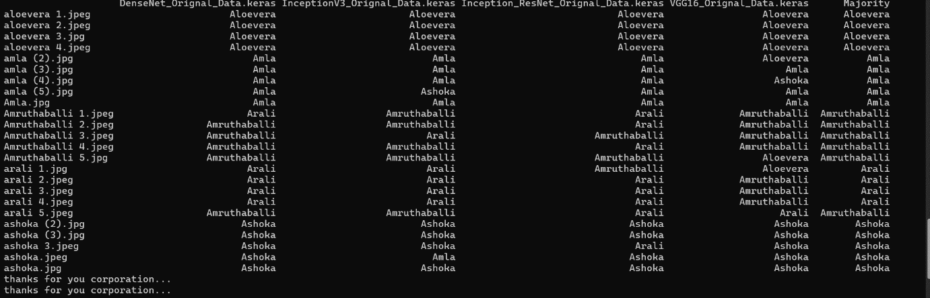
PREDICTION RESULT

Slide 13
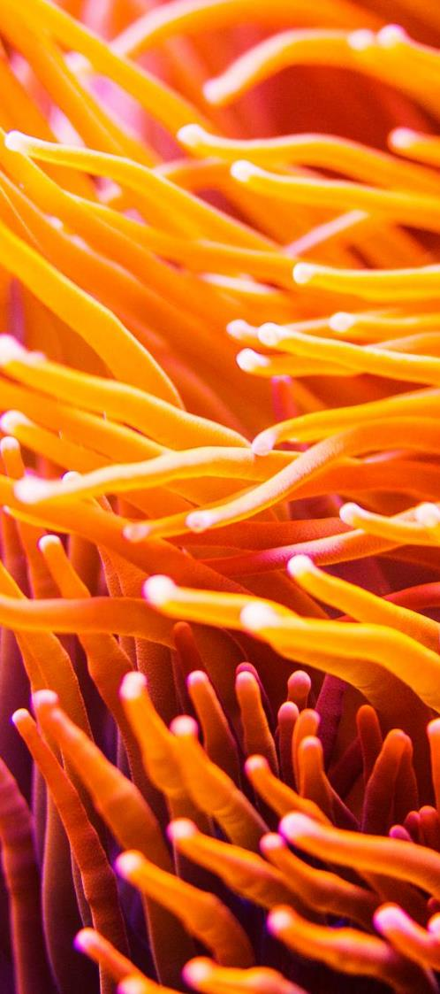
Challenges and Limitations
Future Work
Challenges:
High variability in the appearance of plants due to factors like lighting and angle.
Limited hardware resources for training and deploying the model.
Limitations:
Dependency on high-quality images for accurate results.
Risk of overfitting in the machine learning model.
Difficulty in explaining the model's decision-making process.
Improvements:
Develop custom machine learning models tailored specifically for plant recognition.
Enhance the quality and diversity of the dataset used for training.
Create a user-friendly web application for wider accessibility.
Explorations:
Implement real-time plant recognition capabilities.
Integrate with Geographic Information System (GIS) platforms for location-based identification.
Ensure cross-platform compatibility to reach a broader audience.

Slide 14
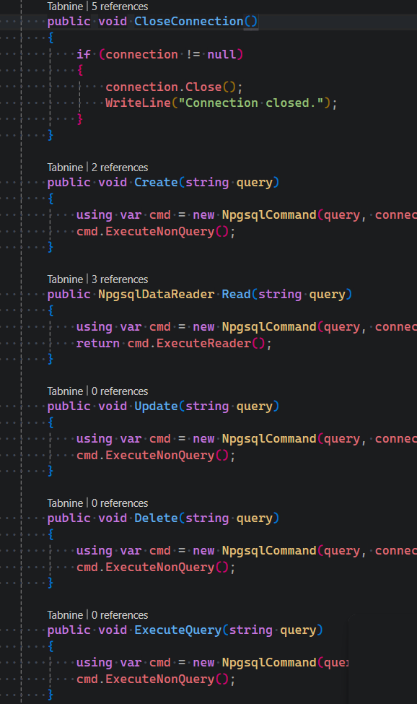
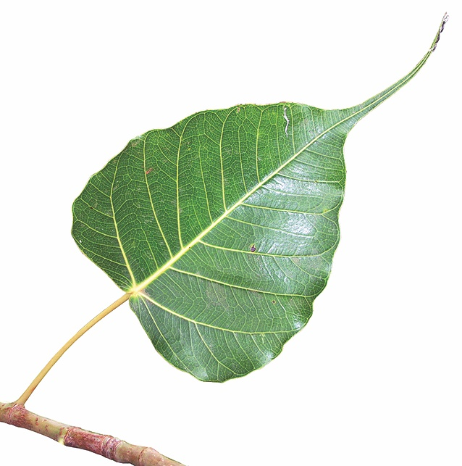
Conclusion
Summary: The project successfully developed an AI-based system for recognizing and classifying medicinal plants, demonstrating high accuracy and efficiency.
Impact: The system has potential applications in botany, healthcare, and environmental science, contributing to the identification and conservation of medicinal plants.

Slide 15
REFERENCES
Dataset: B R, Pushpa; Rani, Shobha (2023), “Indian Medicinal Leaves Image Datasets”, Mendeley Data, V3, doi: 10.17632/748f8jkphb.3
“State of the World’s Plants and Fungi | Kew,” Kew.org, 2016. https://www.kew.org/science/state-of-the-worlds-plants-and-fungi (accessed May 16, 2024).
“The impact of disasters and crises on agriculture and food security,” 2017. Available: https://openknowledge.fao.org/server/api/core/bitstreams/0f03a24f-8d37-4700-aef4-fc436ff32021/content
Bsienvis.nic.in, 2015. http://www.bsienvis.nic.in/Database/Plant-Discoveries-2020_20977.aspx (accessed May 16, 2024).
WWF, “BENDING THE CURVE OF BIODIVERSITY LOSS LIVING PLANET REPORT 2020,” 2020. Available: https://www.wwf.org.uk/sites/default/files/2020-09/LPR20_Full_report.pdf
X. Qin, Zichen Vincent Zhang, C. Huang, M. Dehghan, O. R. Zaïane, and M. Jägersand, “U2-Net: Going deeper with nested U-structure for salient object detection,” Pattern recognition, vol. 106, pp. 107404–107404, Oct. 2020, doi: https://doi.org/10.1016/j.patcog.2020.107404.
B. Dey, J. Ferdous, R. Ahmed, and J. Hossain, “Assessing deep convolutional neural network models and their comparative performance for automated medicinal plant identification from leaf images,” Heliyon, vol. 10, no. 1, pp. e23655–e23655, Jan. 2024, doi: https://doi.org/10.1016/j.heliyon.2023.e23655.
P. Sarma, Parvez Aziz Boruah, and Rubul Buragohain, “MED 117: A dataset of medicinal plants mostly found in Assam with their leaf images, segmented leaf frames and name table,” Data in brief, vol. 47, pp. 108983–108983, Apr. 2023, doi: https://doi.org/10.1016/j.dib.2023.108983.
S. Kavitha, T. Satish Kumar, E. Naresh, V. H. Kalmani, Kalyan Devappa Bamane, and Piyush Kumar Pareek, “Medicinal Plant Identification in Real-Time Using Deep Learning Model,” SN Computer Science/SN computer science, vol. 5, no. 1, Dec. 2023, doi: https://doi.org/10.1007/s42979-023-02398-5.
P. Sarma, Parvez Aziz Boruah, and Rubul Buragohain, “MED 117: A dataset of medicinal plants mostly found in Assam with their leaf images, segmented leaf frames and name table,” Data in brief, vol. 47, pp. 108983–108983, Apr. 2023, doi: https://doi.org/10.1016/j.dib.2023.108983.

Slide 16
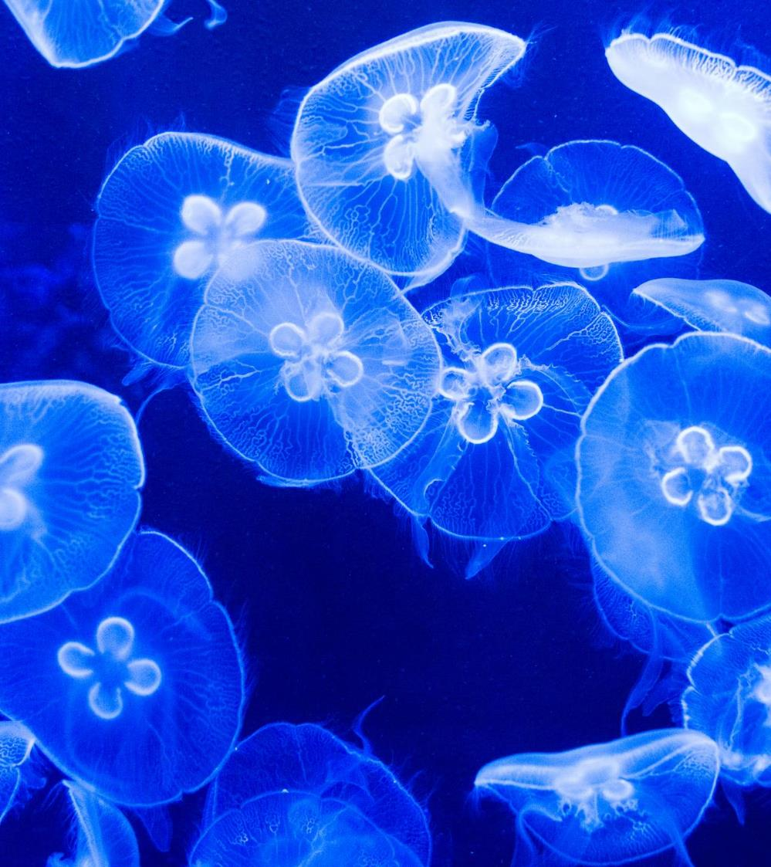
THANK YOU

